Slide 1

Follow-up Training 2023

Slide 2
Main Purpose: To collect Perkins Core Performance Indicator — Post-program Placement (3S1)
CTE concentrators who exited during the reporting year
Were in placement 2nd quarter after exiting high school:
Postsecondary Education/Advanced Training
Employment
Military Service
National and Community Service Programs
Peace Corps Volunteers
Notes:
3S1 denominator is CTE concentrators who left school and responded to the follow-up survey. So high response rate of the follow-up survey is critical to ensure that the respondents of follow-up survey can sufficiently represent all CTE concentrators who left school.
The survey data are used in a variety of ways at both the Federal and State levels. At the Federal level, OCTAE uses the data to show the impact of CTE funding to the U.S. Legislature. This may, in turn, affect future federal funding. Similarly, MDE uses the data to show the impact of State funding of CTE programs to the Michigan legislature. Additional data uses by the State include:
Ranking programs to allocate Added Cost funds.
Program review consideration of the data in answering questions such as “Are CTE concentrators finding jobs or continuing their training in a related field?”

Slide 3
Post-Program Placement – 3S1
Year | Total eligible concentrators | Response Rate | Proxy Rate | Self-Survey | Placement | Employed | Continuing Education
2021-22 | 35,266 | 84.5% | 12.6% | 21.3% | 95.2% | 86.2% | 68.4%
2022-23 | 37,407 | 86.3% | 11.8% | 23.6% | 95.4% | 88.2% | 69.9%

Slide 4
Importance of Response Rate
Understand the importance of response rate to the quality of the CPI post-program placement indicator—3S1.
Perkins V requires states to report post-program placement of all CTE Concentrators. This means that we need to make a good faith effort to survey all qualified concentrators, as well as a good response rate to accurately portray all concentrators in the state.
The value of the data collected through the Follow-Up Survey depends on an accurate report of the status of all concentrators. A good response rate is necessary to accurately portray all concentrators in the state.
Previous verification studies have shown that districts with low response rates often under-report their placement rates because they failed to reach students who were employed during regular weekdays.

Slide 5
Low Response Rate
A low response rate negatively affects buildings, CEPDs and the state by reducing the accuracy of the placement information used to evaluate CTE programs.
Institutions with response rates below 80% may be found to be in noncompliance during a TRAC onsite monitoring visit.
Districts with one or more buildings with response rates below 50% will be required to send a representative to a technical assistance workshop before next Follow-Up survey.

Slide 6
Tips
When to call. It is particularly important that your follow up interviewers attempt to reach students in the evenings and on weekends in addition to during school hours.
Answering Machines. It was helpful to leave a message stating the purpose of the call. Students were more apt to answer the next call. “A plea for help also works.”
Caller ID. Make your calls from the school. Students are more likely to answer if interviewers call from the school or they recognize the interviewer’s name. Use a cell phone or calling cards which do not activate Caller ID.
Reaching students. A phone survey provides the highest response rates. Contact students by e-mail to tell them of the coming survey and to get a current phone number. Ask for e-mail accounts, especially universal accounts like Gmail/Hotmail accounts, before they leave school.
Disconnects. Try to call a relative listed on the student’s emergency card to get a current number. If that fails, try mailing a postcard to the current address or a relative. A disconnected number does not eliminate the student from the pool of concentrators, so you should make every effort possible to reach the student.
Other recommendations for improving the response rate can be found on page 9 in the protocol manual.
Notes:
CTEIS Follow Up Survey of Concentrators Best Practices on CTEIS knowledge base webpage: follow-up
Teacher/ISD best practice

Slide 7
Proxy Rate
Buildings with proxy rates higher than 20% will be required to attend a follow-up training before the next follow up survey. This will be included in the follow-up protocol manual and these buildings will receive a letter indicating the requirement.
The proxy rate requirement for the TRAC risk analysis and compliance finding will be reduced.
For TRAC risk analysis: Regions that have 1 or more buildings with a proxy rate greater than 20% will be flagged on the risk analysis.
For TRAC onsite visit: Regions that have a regional proxy rate greater than 20% will receive a finding of noncompliance and be required to prepare a compliance plan.
Notes:
These policies will be implemented starting with the 2021-2022 school year, using 2021-2022 follow-up data.

Slide 8
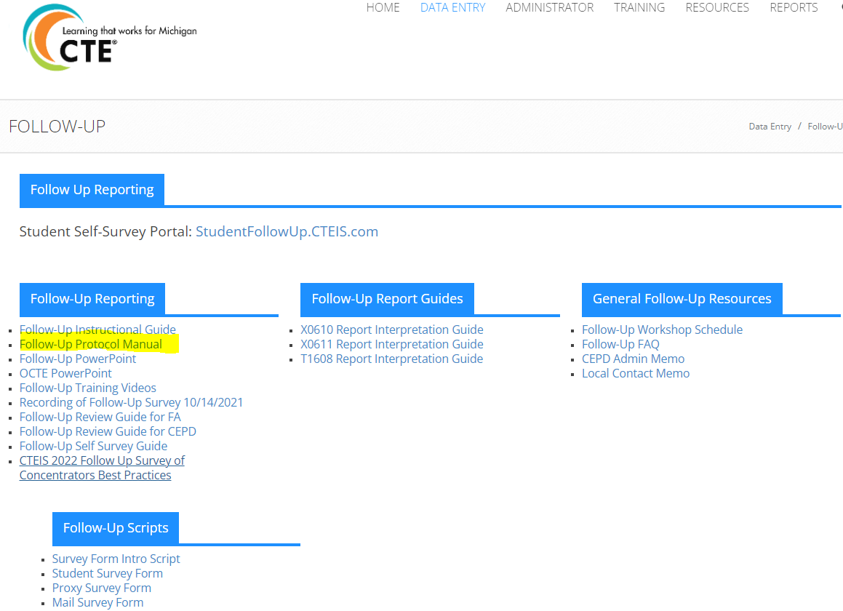
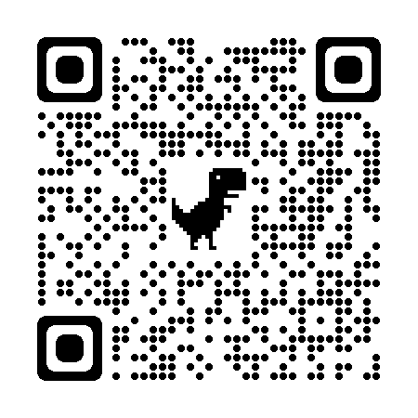
Use of Follow-up Protocol Manual
Response Rate & Proxy Rate requirement
Guidance on how to get survey items one by one
Background and purpose of follow-up survey

Slide 9
Contact Information
Yincheng Ye
YeY@michigan.gov
517-281-7229 Cell

